Slide 1

POS Restated

Slide 2
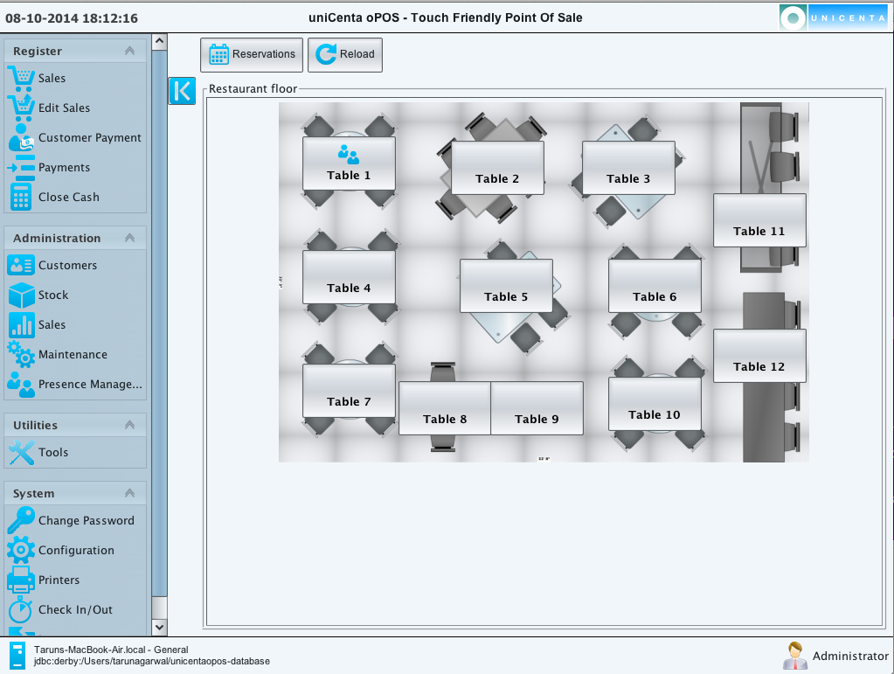
Table Structure/ Orders

Slide 3
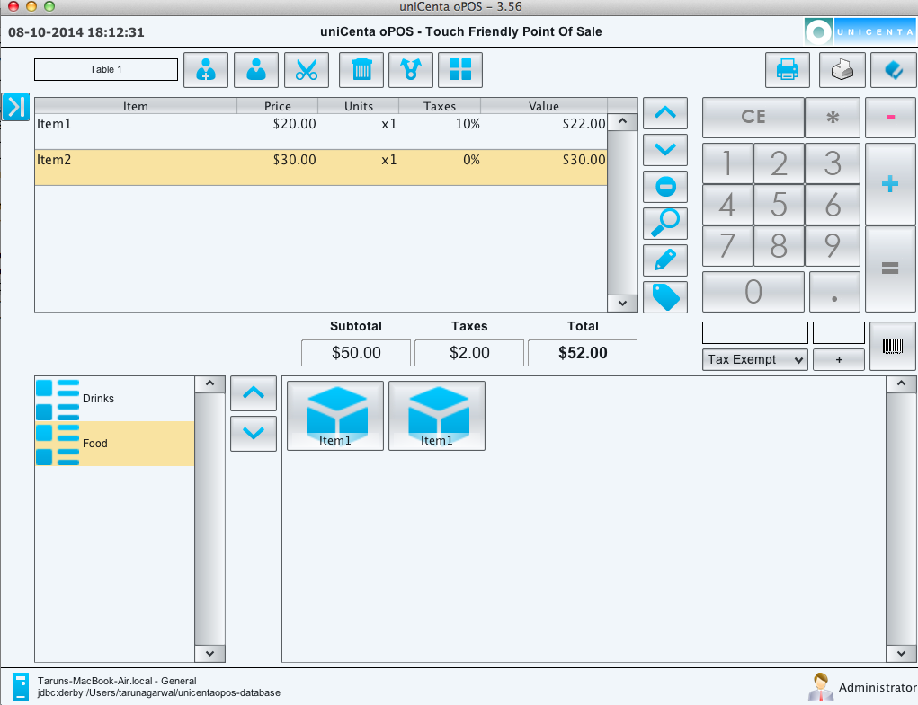
Ordering

Slide 4
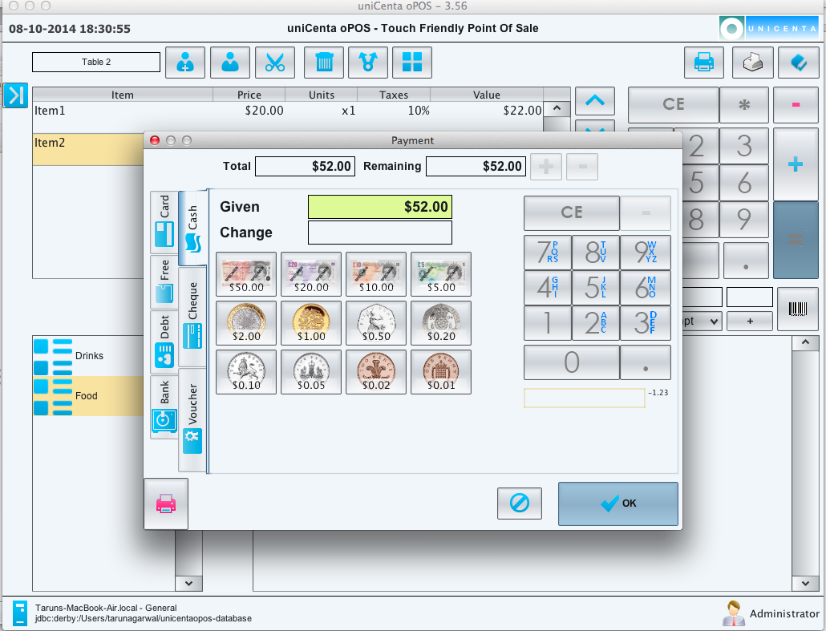
Payment

Slide 5
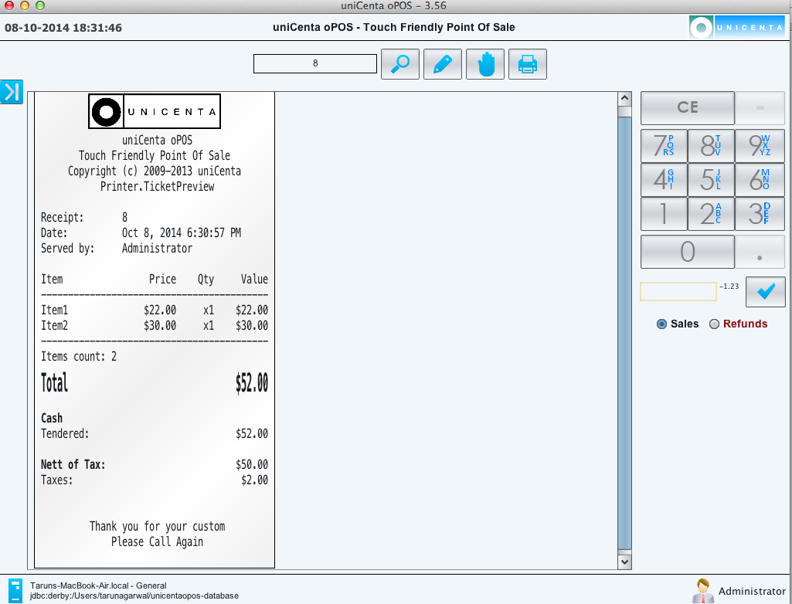
Receipts

Slide 6
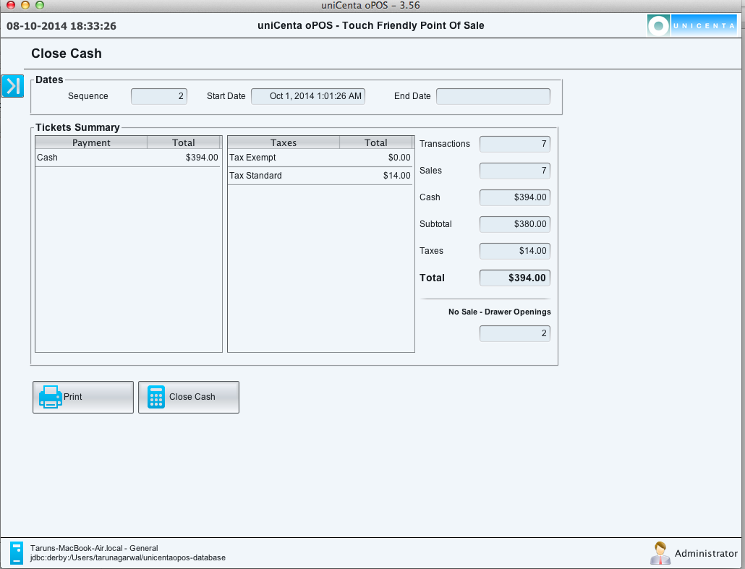
Cash Management

Slide 7
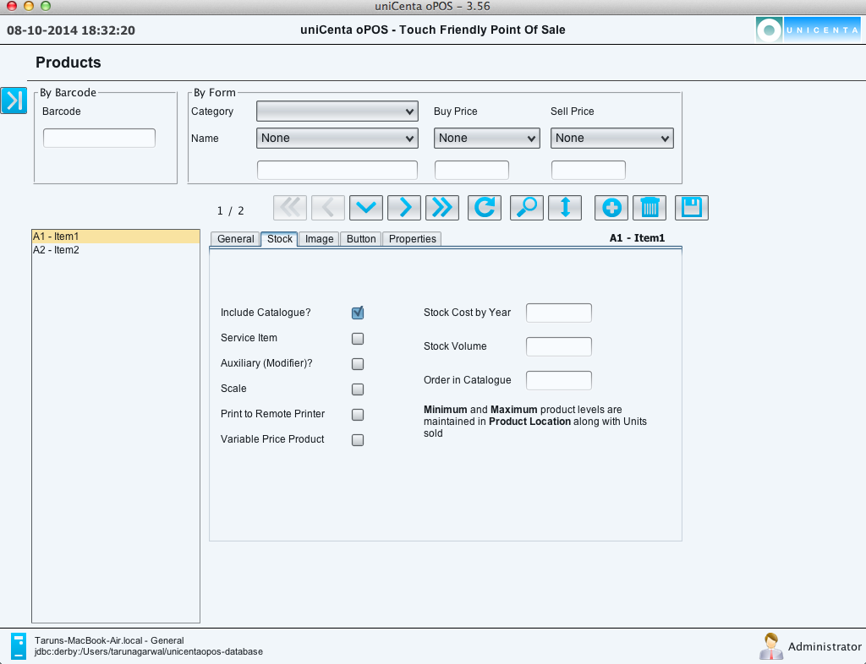
Inventory Management

Slide 8
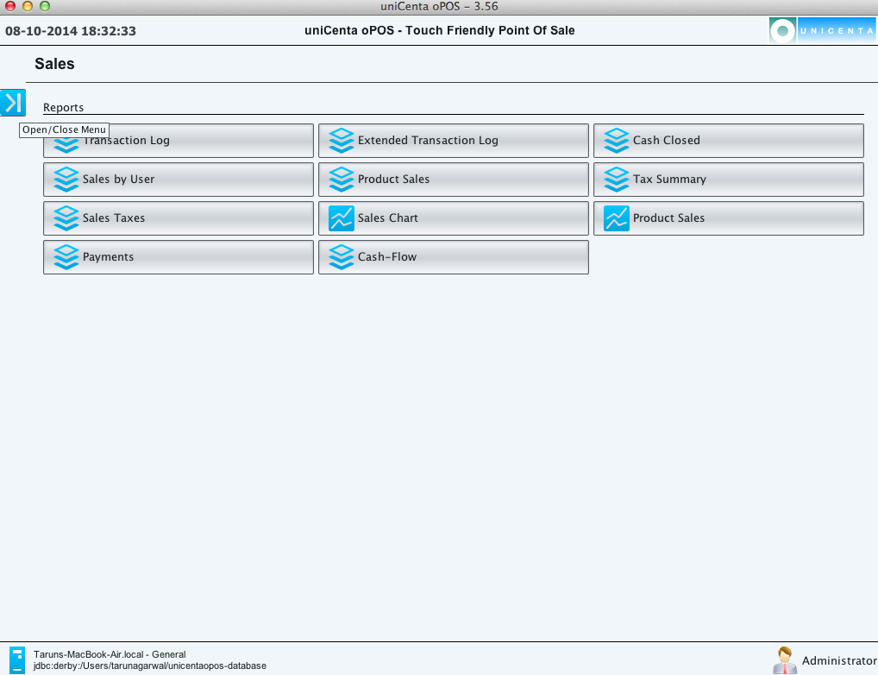
Sales Reports

Slide 9
POS Restated

